Slide 1

Channel Support Procedures

Slide 2
Table of Contents:
Channel Support Items
How to Escalate Issues to Mezzanine Support Agents

Slide 3
Channel Support Items
For recommended support steps, see:
  https://wiki.stb.mezzanineware.com/display/ES/Mobile+Device+Related+Support
SIM and Device issues handled by the Channel Partner:
* Mobile Data and Zero Rated Check | Second Line
* Faulty Device Troubleshoot | Second Line
* Device Reboot in Order to reset faulty Application | Second Line
* SIM swaps | Second Line
* SIM card check/troubleshoot | Second Line
* Internet Settings check | Second Line
* Device/SIM Blacklisting | Second Line

Slide 4
Escalating Issues to Mezzanine Support
There are three methods to escalate issues to Mezzanine Support. All methods are described in detail in the next few slides.
Go to https://support.mezzanineware.com/ and register as an end user. Then log the ticket.
Send an email to support@mezzanineware.com describing the issue and what troubleshooting steps were taken to try to resolve the issue.

Slide 5
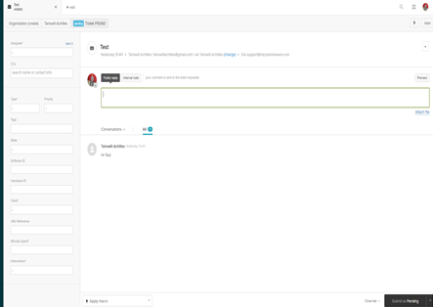
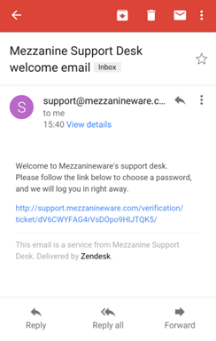
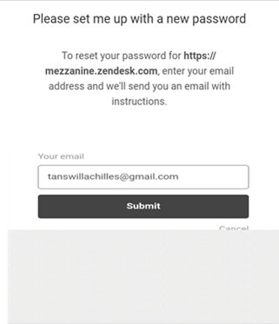
Escalating Issues to Mezzanine Support
The Channel partner can send an email to support@mezzanineware.com with full description of User’s problem and the troubleshoot steps taken so far. Once the email is sent, Zendesk will automatically create a ticket on Mezzanine’s portal and the requester will receive two emails back the first time they log a ticket. Another method is to log a ticket via https://support.mezzanineware.com/. | The first email will be a welcome email and only received if the Agent logs an issue for the first time. This email will have a link where the agent can log unto the portal to create password in order to track their request on our web portal. Once the agent clicks on the link they will see the registration screen where their email address is required. The agent should complete the registration process.

Slide 6
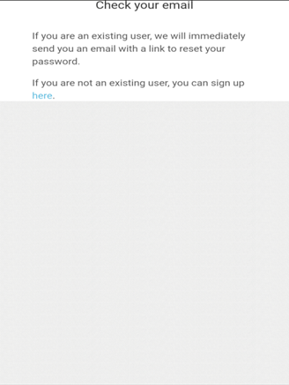
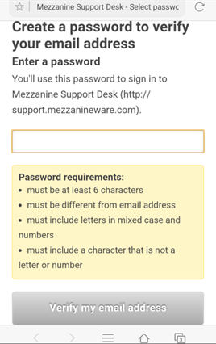
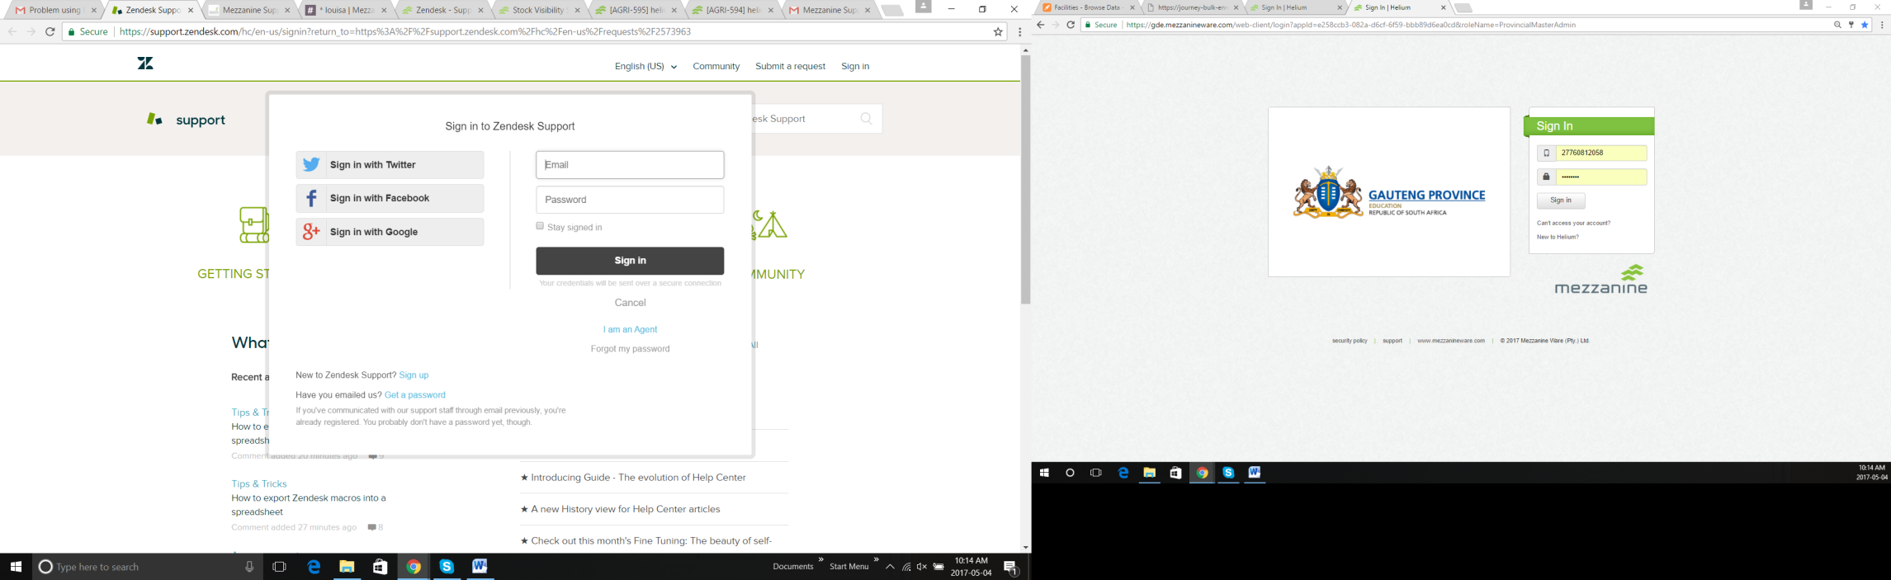
Escalating Issues to Mezzanine Support
When agents click on the submit button they will receive a screen that confirms another link was sent to set their password. Existing users (agents who have logged Issues before) who never used the website to track tickets may click on Sign up. | After sign-up, users will be redirected to a screen where they can create a password and verify their email address.

Slide 7
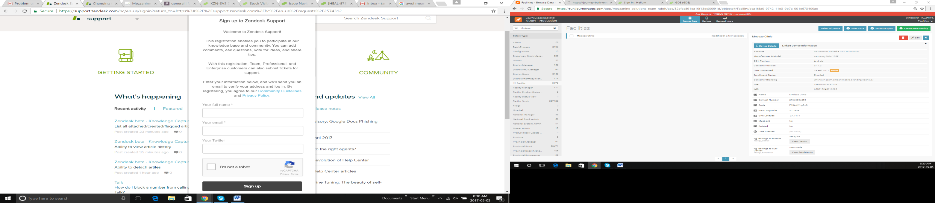
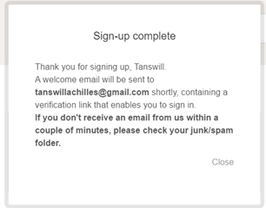
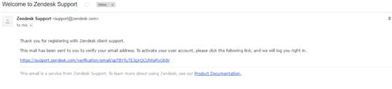
Escalating Issues to Mezzanine Support
You will now see the following screen where you can sign up for Zendesk support. Once you have completed the form click on “Sign up”.
After clicking on “Sign up” you will receive a message that confirms that the sign up has been completed, and the mail that welcomes you to Zendesk. Click on the link to confirm your details.

Slide 8
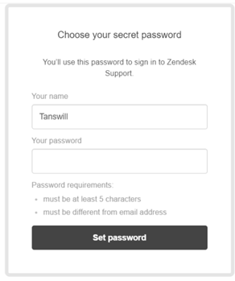
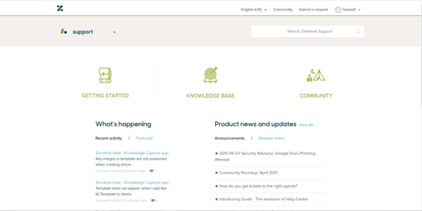
Escalating Issues to Mezzanine Support
Once you have clicked on the link it will redirect you to a screen where you need to set your password.
Once you have set your password you will see the Zendesk home screen.

Slide 9
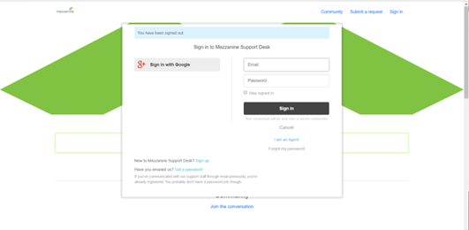
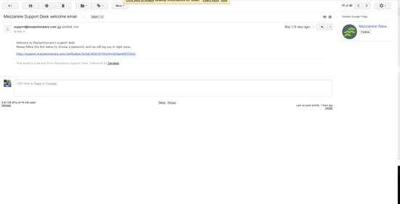
Escalating Issues to Mezzanine Support
Once the sign up process is completed, you can click on the link below to view the status of your request.
When you have clicked on the link you will get the login screen where you will need to sign in with your email address and the password you have chosen.
e.g. “Your request (#10063) has been received, and will be reviewed by the Mezzanine Support Desk staff shortly.
To review the status of the request and add additional comments, follow the link below:
http://support.mezzanineware.com/hc/requests/10063

Slide 10
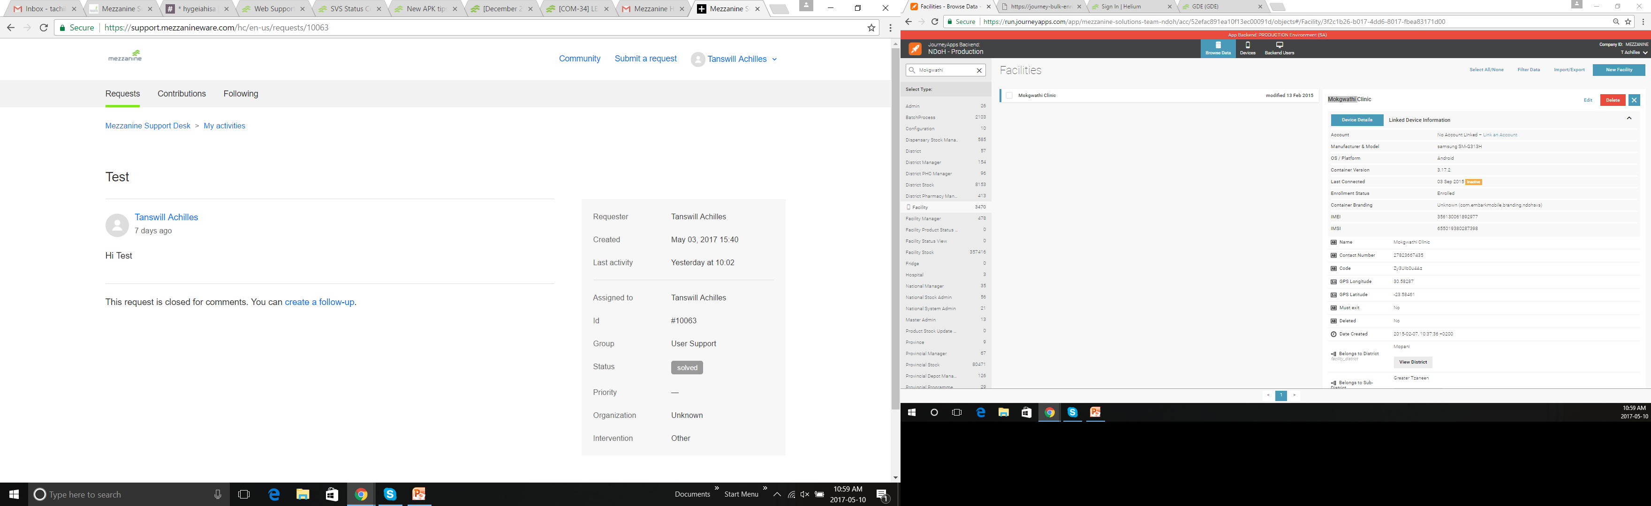
Escalating Issues to Mezzanine Support
You can now review the status of your ticket and create follow-ups, once you are logged in.

