Slide 1
Connected Farmer

Slide 2


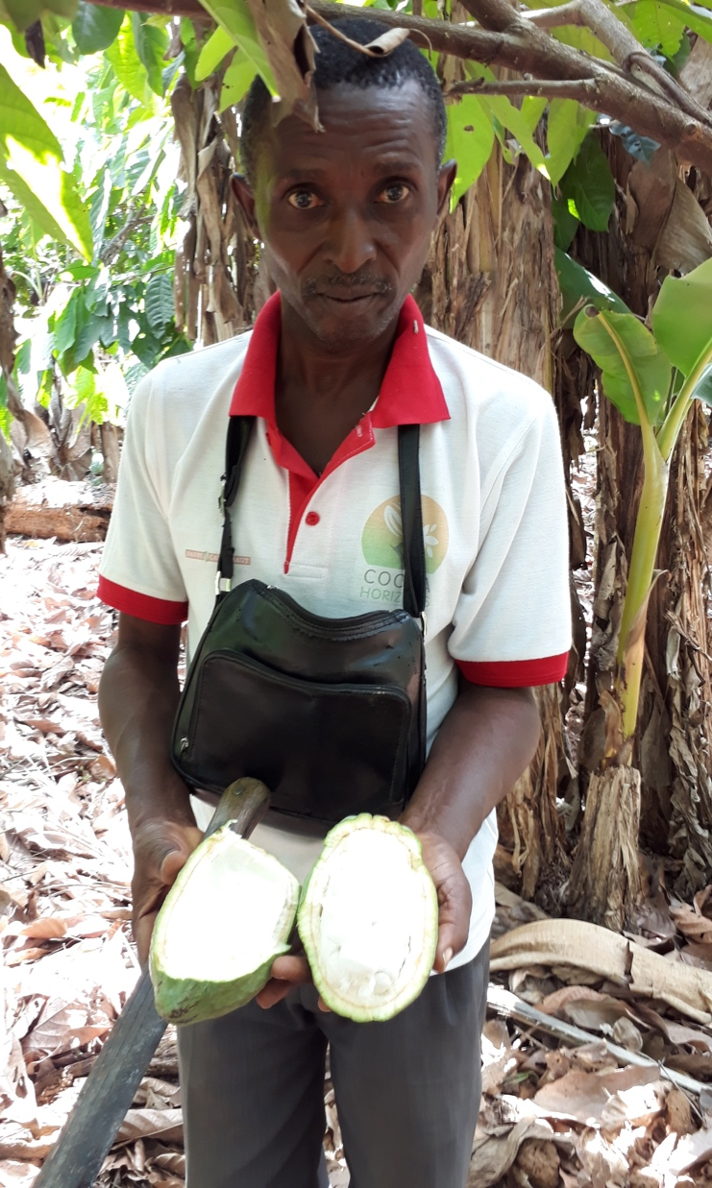
If you had breakfast today…
Thank these farmers
Notes:
Lucy the dairy farmer = typical dairy farmer produces 6kg per cow per day. What is needed to double that production?
Training on Animal Husbandry, AI products, Feed & Fodder production and storage for the dry season. Save cost of high energy meal on your dry cows etc.
Access to good semen to improve herd quickly
Access to credit to do these things.
Coffee = 3-4kg per tree per year => We can play a part with Digital technology to double that and make coffee farming profitable.
Padmore the cocoa farmer & buyer for PBC
2-3 bags per acre on average Good = 12 bags
Access to credit
buy inputs - fertiliser and fungicides Cocoaboard does provide these services…but does it reach enough farmers – at the right time?
new variety trees seedlings
Transport or proximity to Buying Centres

Slide 3
Farmers
Economics
0.1% population;
access to 82m
Ha (2 000/f)
95% of commercial
agri output (almost
all Agri credit)
30-40k
(10k cropping)
Commercial
200 000
to 300 000
1% of population
(access to 6.3m
Ha (<25 Ha/f)
<5% of commercial
agri output (limited
credit available)
Small Holder
2.5mil
to 3.0mil
<10% of population (<14.5m Ha, or 5Ha/f)
<1% of commercial
agri output (no
credit available)
Subsistence

Slide 4






Content providers
The “actors in the movie”
Weather content
GAP content
Agri-Business
Market prices
Web
Create & share Information & value
Connected Farmer
Field workers
as a
Mana
Farmer
g
ed
Se
r
vice
Mobile application
Capture Information
Feature Phone
Consume Information
Receive value
Notes:
AB => Value is reduce risk and losses
Field workers => ease workload and paperwork inefficiencies
Farmer => Access to markets (inputs and off-takers), Info, Finance
SA
Zambia
TZ
Nigeria
MZ
KE
Ghana

Slide 5

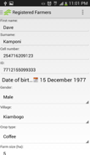


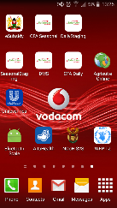
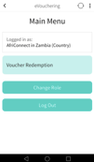
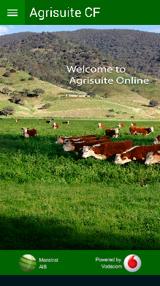




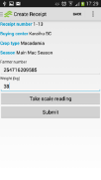
Field worker view
CF+ License (CF plus ASO)
Registration &
Profiling
CF License
Plant production
Animal production
Surveys
Weather
Animal
products
Vouchering
How to’s
Agri directory
eReceipts
SAFEX

Slide 6
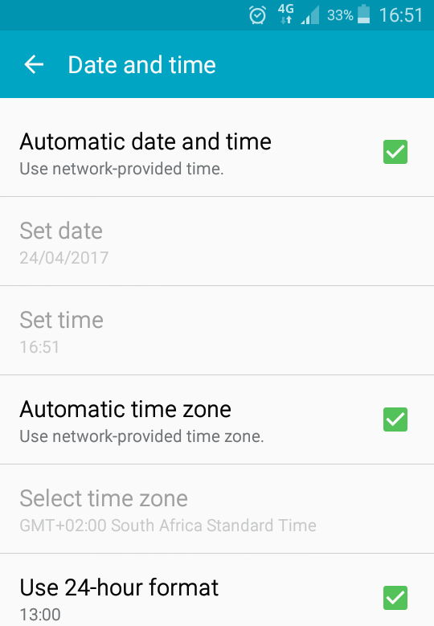
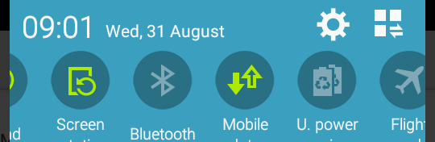
General phone settings
Your phone date and time setting is used by Connected Farmer
Check you date and time – make sure it is correct.
1. Slide your finger from the top downwards
2. Settings (red arrow)
3. Settings / Date & Time

Slide 7
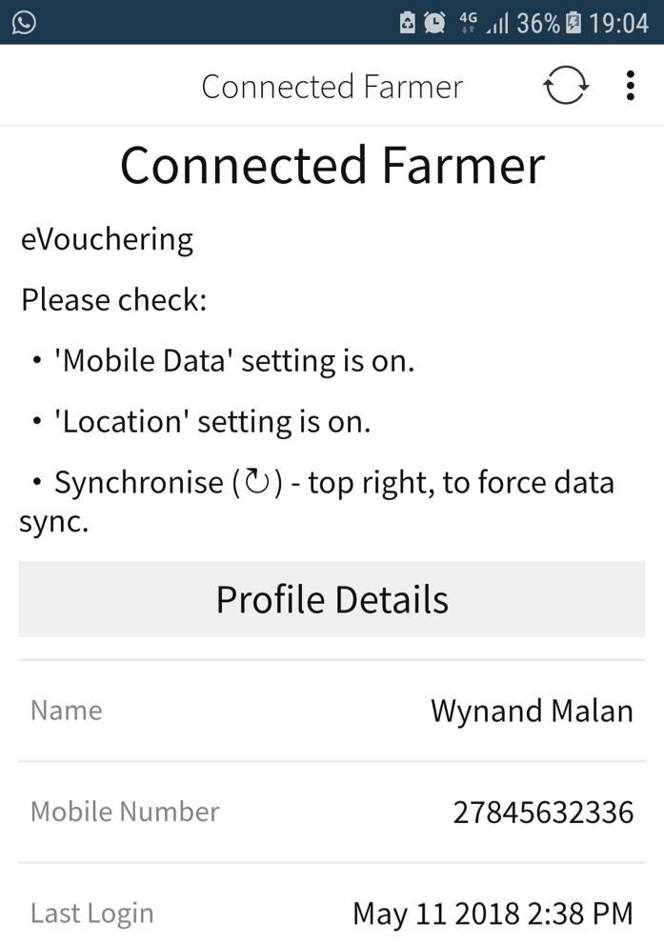
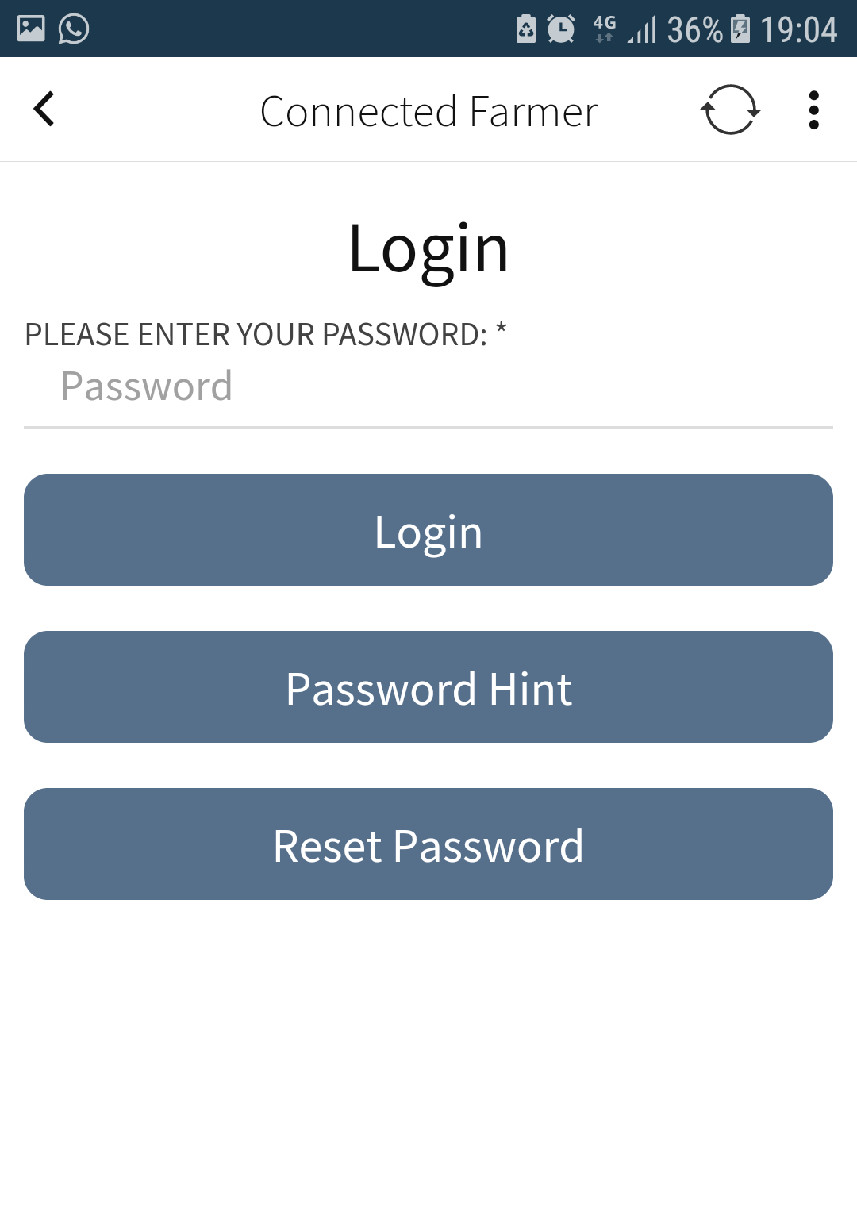
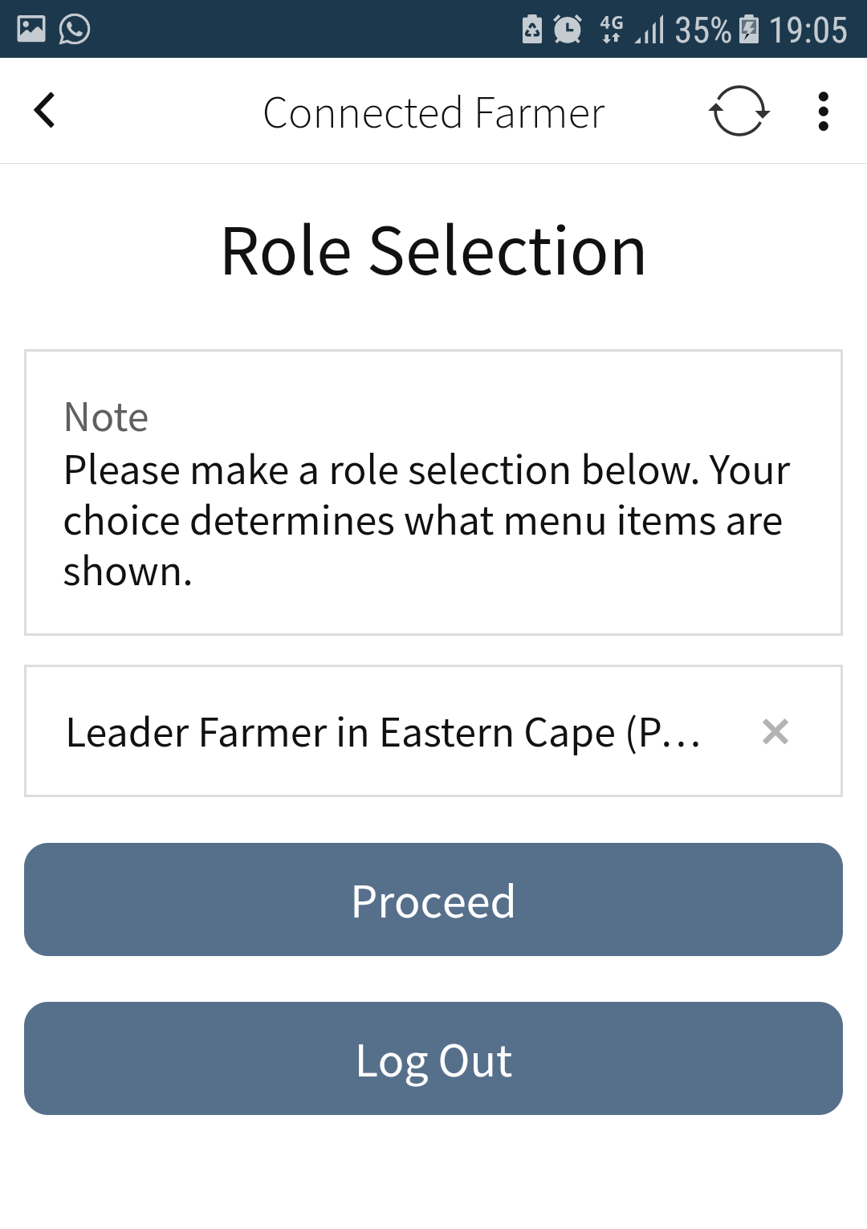
Log in
All mobile users
Default Password is 1234.
You will be then asked to create a personal password.
This will give you a hint on what your personal password is.

Slide 8
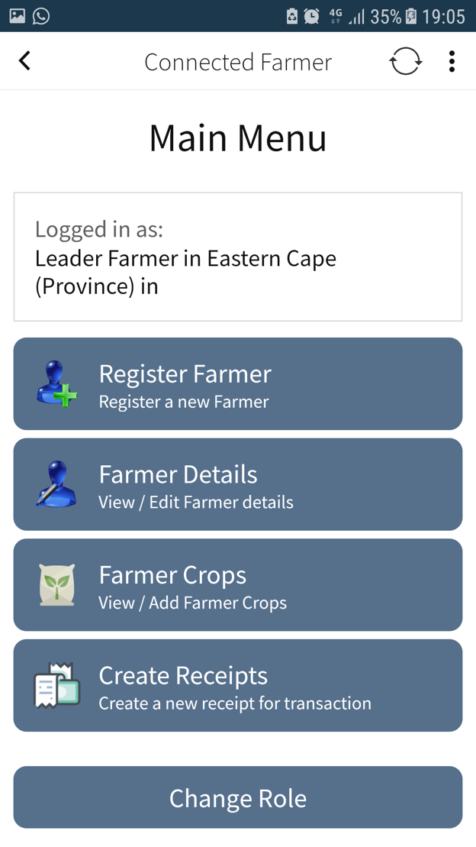
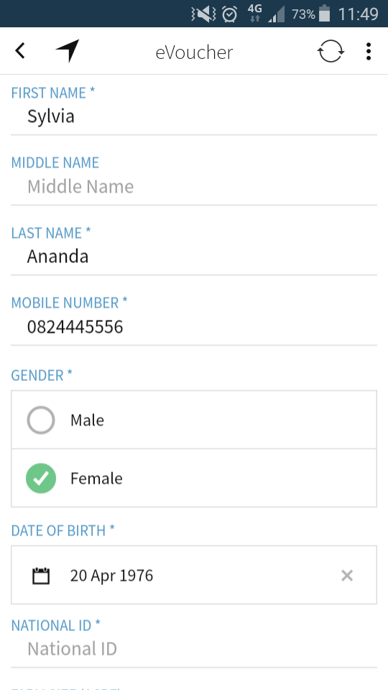
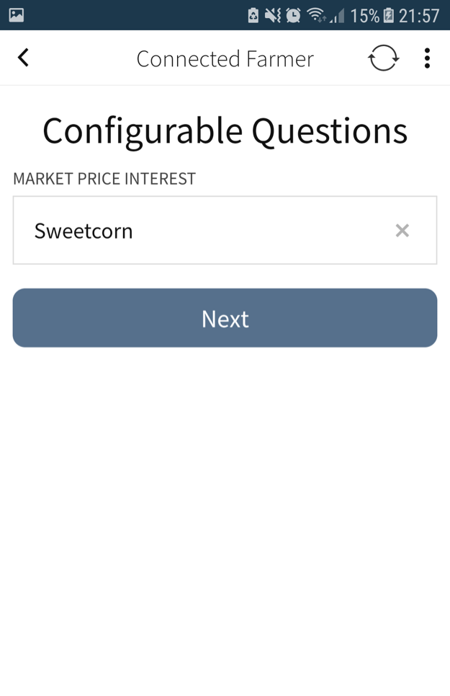
Farmer Registration
Mobile users
Market Price = weekly price SMS on 1 crop of interest. Please explain this to the farmer.

Slide 9
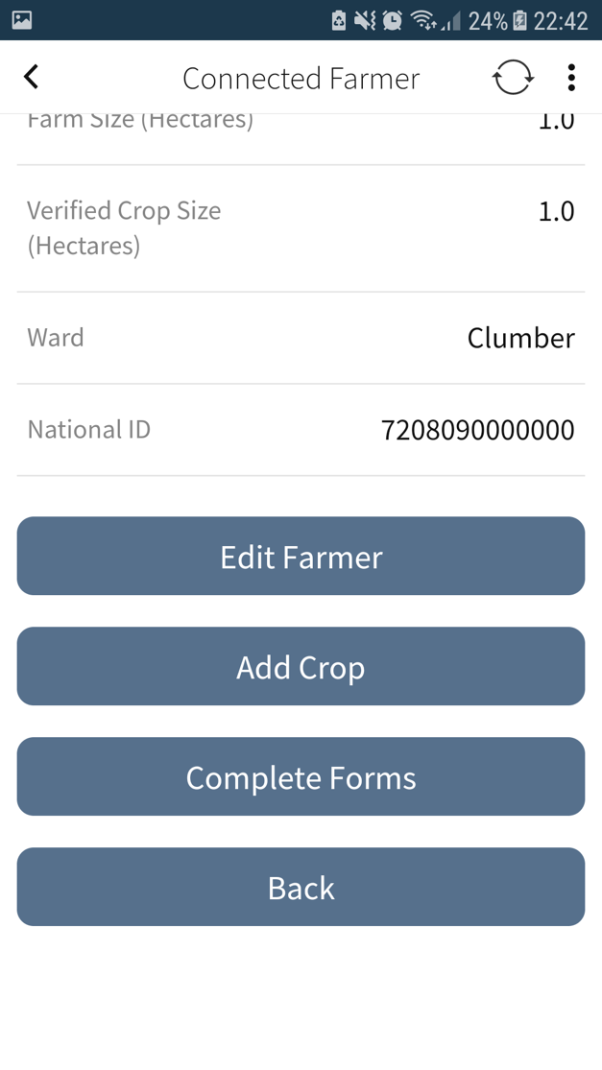
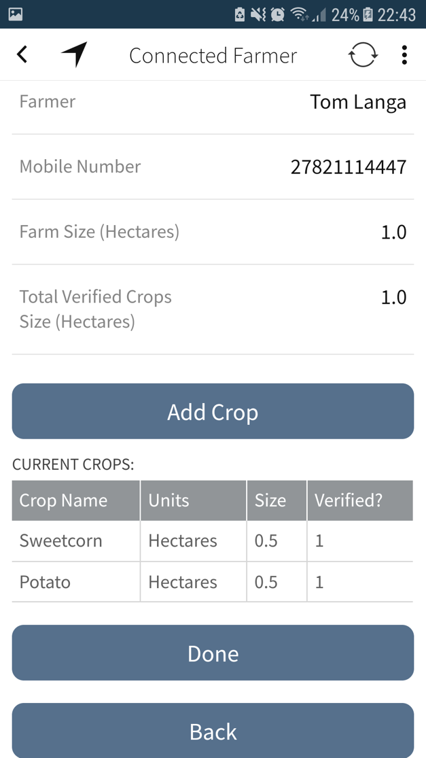
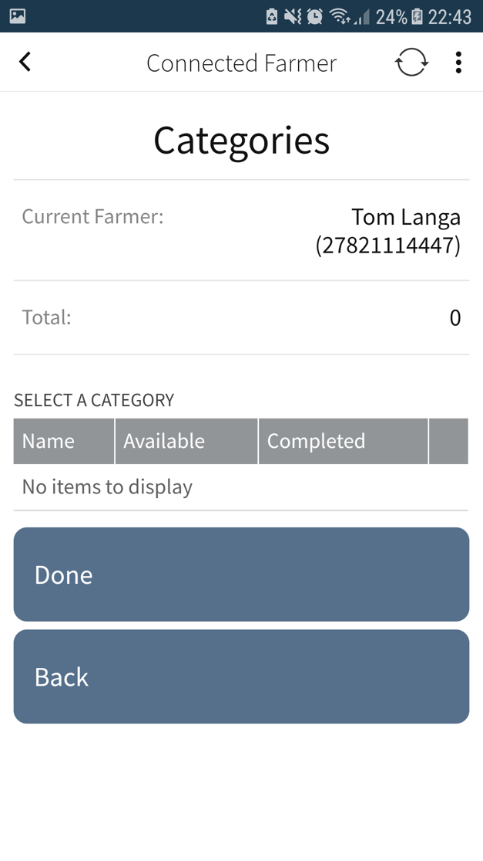
Farm & Crop Registration
Mobile users
“Complete Forms”:
When you have survey / forms to complete, this screen will show the questions.

Slide 10
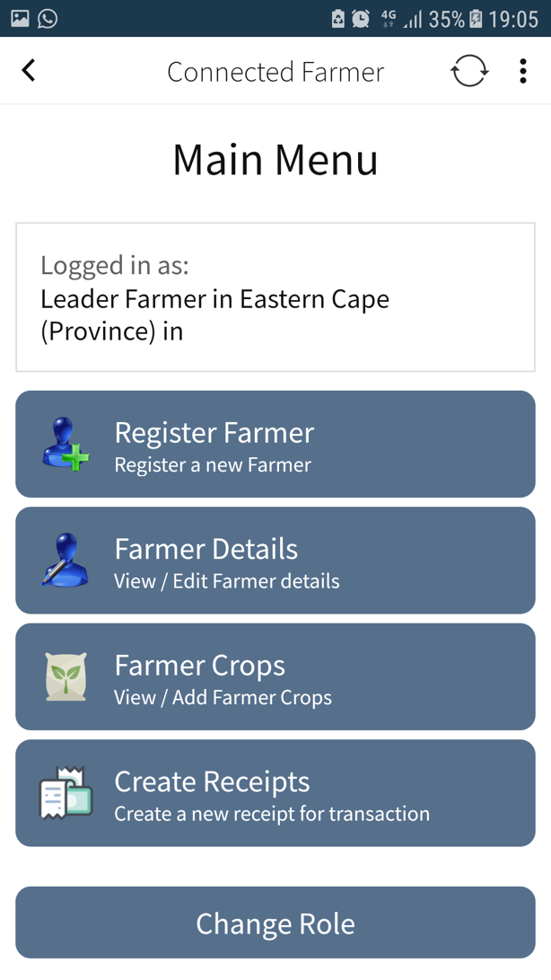
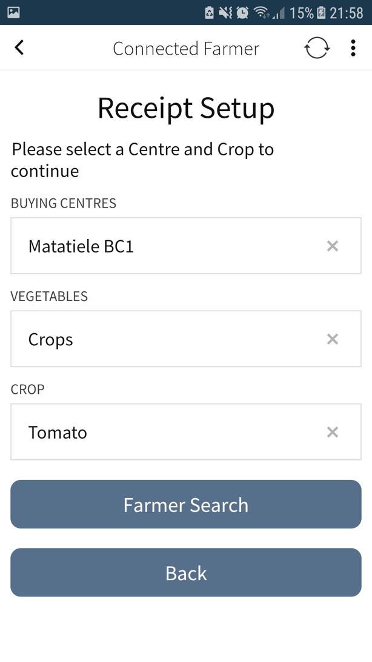
Receipts
Mobile users
Select these 3 values once and capture many receipts with these values.
Once you stop or move you can re-select these values.

Slide 11
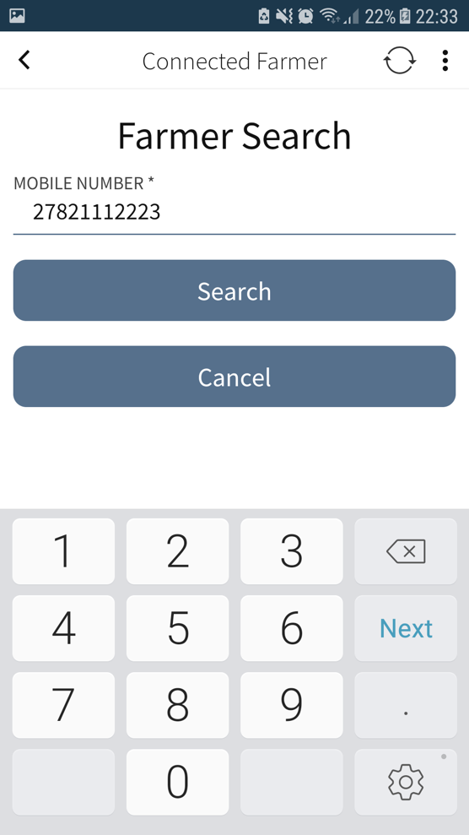
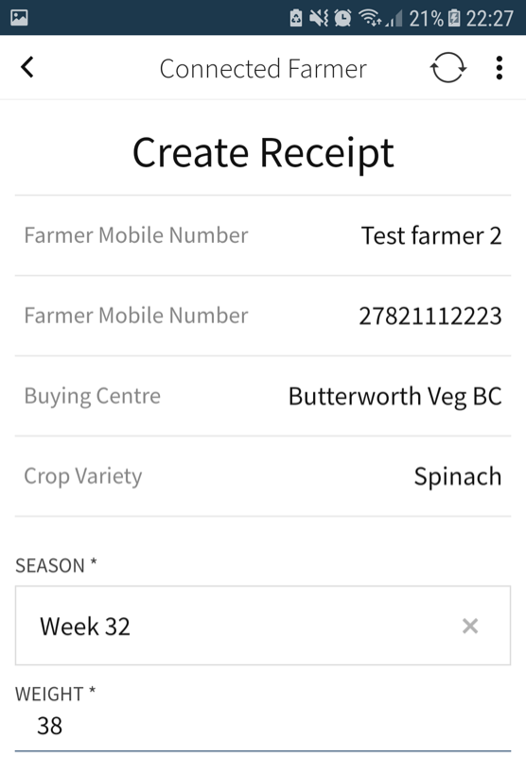
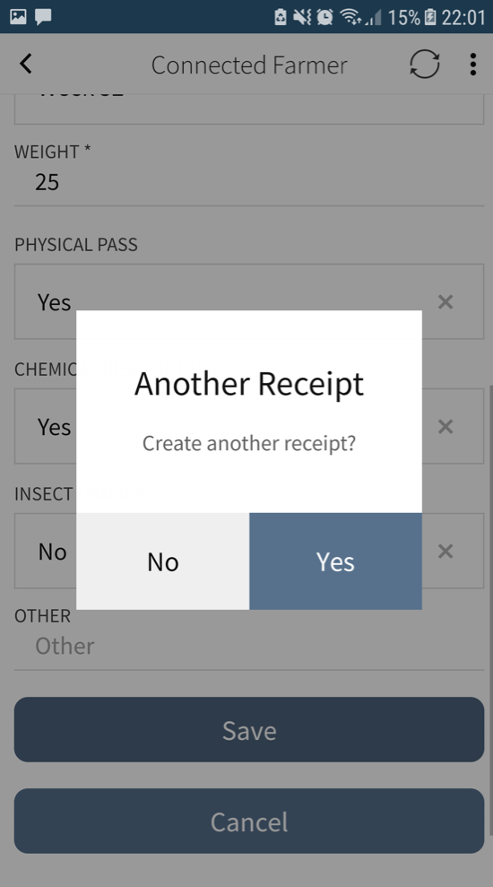

Receipts #2
Mobile users
When you capture many receipts for the same crop at the same Buying Centre, tap on Yes here.

Slide 12
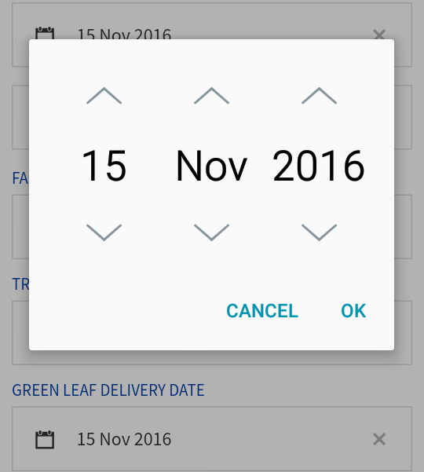
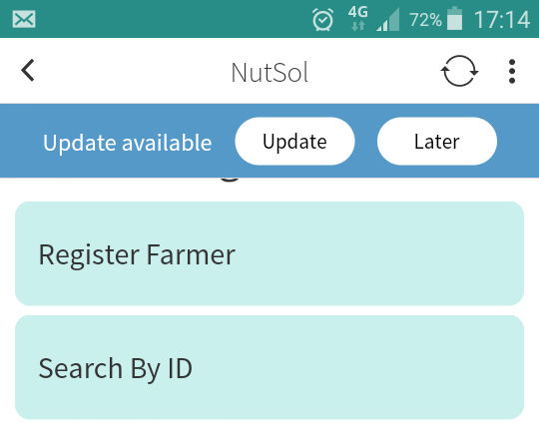
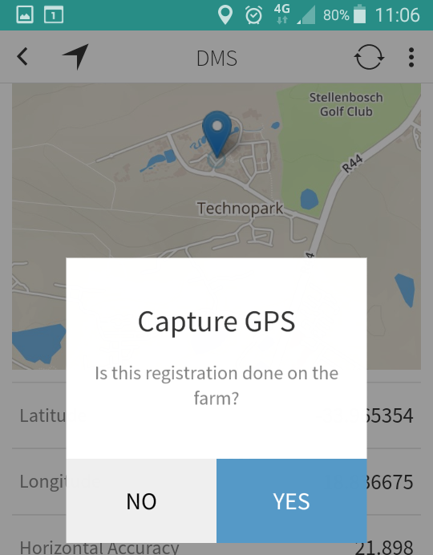
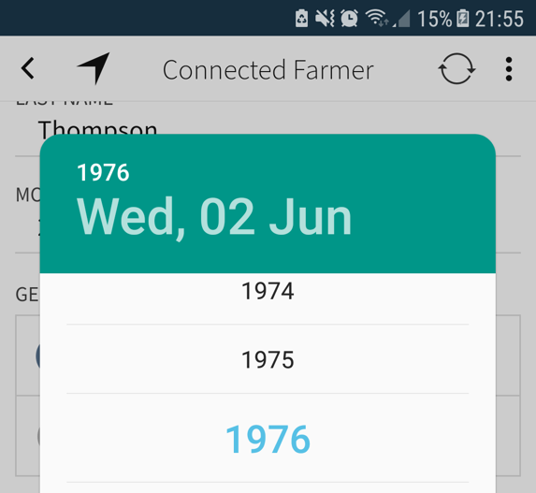
General mobile app use tips
Each phone has different date selections.
Tap on the ^
OR the middle to enter the date or year
When you see this blue band at the top tap the “Update”
When you do farmer registration on the farm – switch your ”Location” on to capture the farm GPS

Slide 13
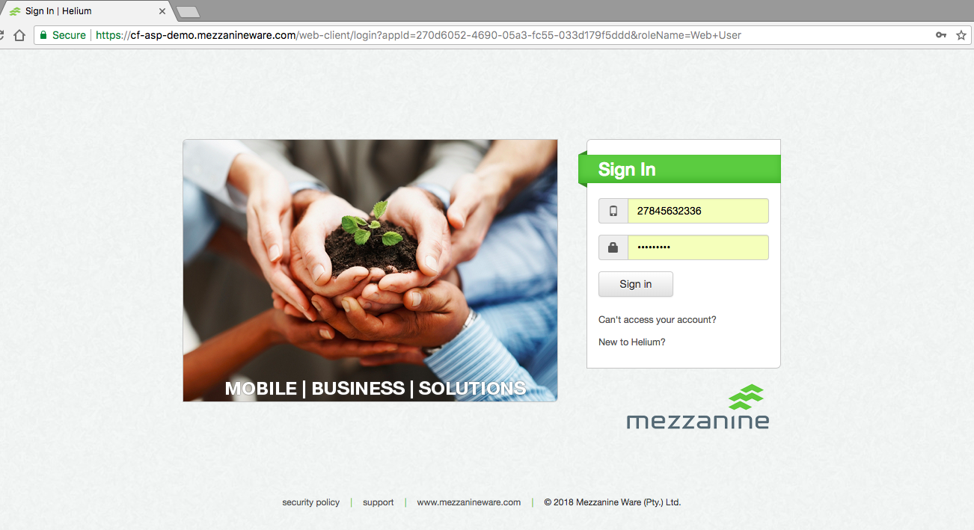
Web Users
You will receive a SMS with a Helium password
Use this to log in the 1st time
Change your password to something personal you will remember.

Slide 14
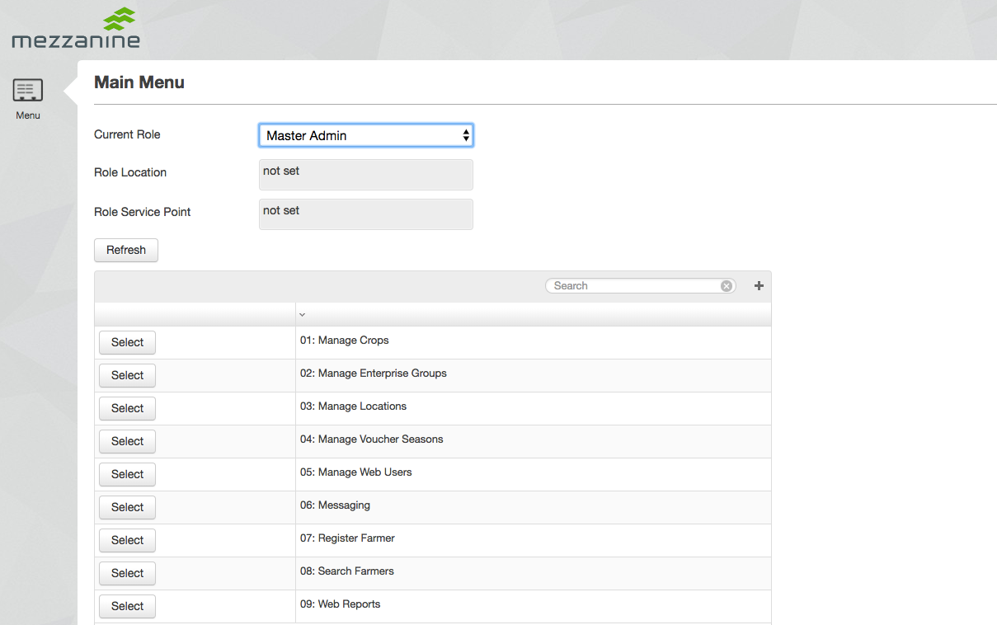
Main web menu
Your User Role will determine the access to the menu items below.
Add more Towns, Municipalities here if they are missing
Seasons are used for receipts & farmer recruit
Invite new web & mobile users here

Slide 15
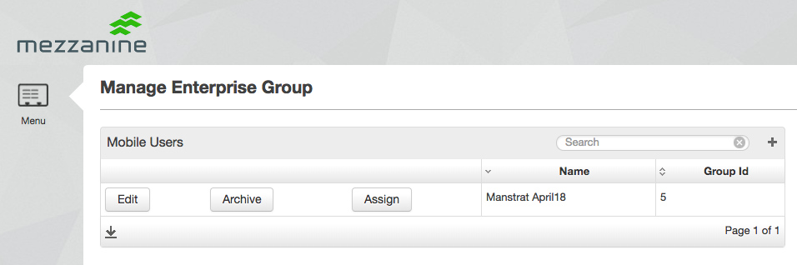
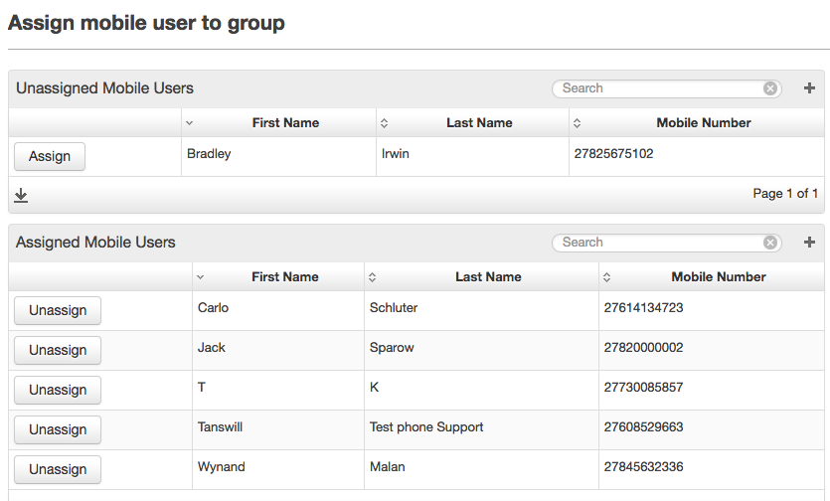
Set up of new Agrisuite Plus users:
Manage Enterprise Groups
Enrol on mobile app
After inviting a new user, the Master Admin must assign this user to your group in order to get access to the AgriSuite Plus mobile app.
Allow 2-3 minutes for the new user record to sync.

Slide 16
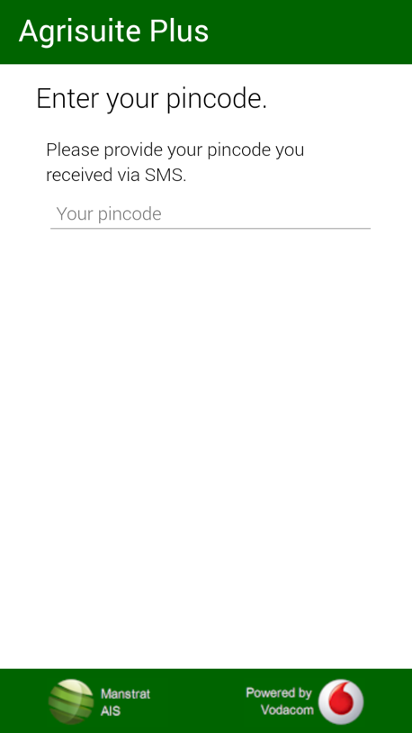
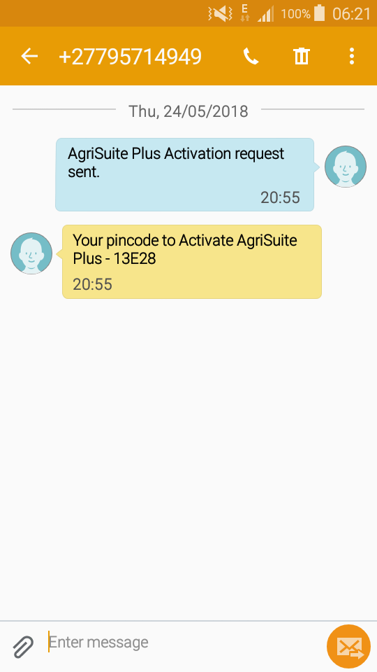
Set up of new Agrisuite Plus users:
Manage Enterprise Groups
Enrol on mobile app
- Download Agrisuite Plus from the play store
- Install and open the app.
- Click Continue to get to this screen.
- Your phone must be able to send 1 SMS (ie you need some airtime for this set up)
- Type in the pin code received via return SMS
- Read the “End User License Agreement” (EULA) and accept in the bottom.

Slide 17
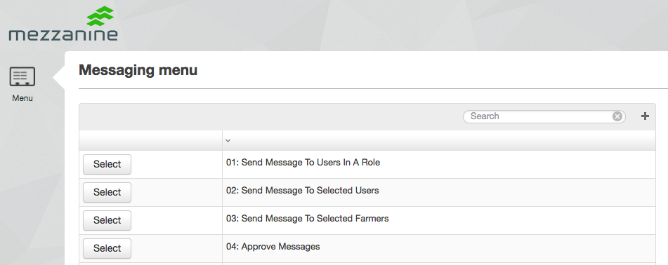
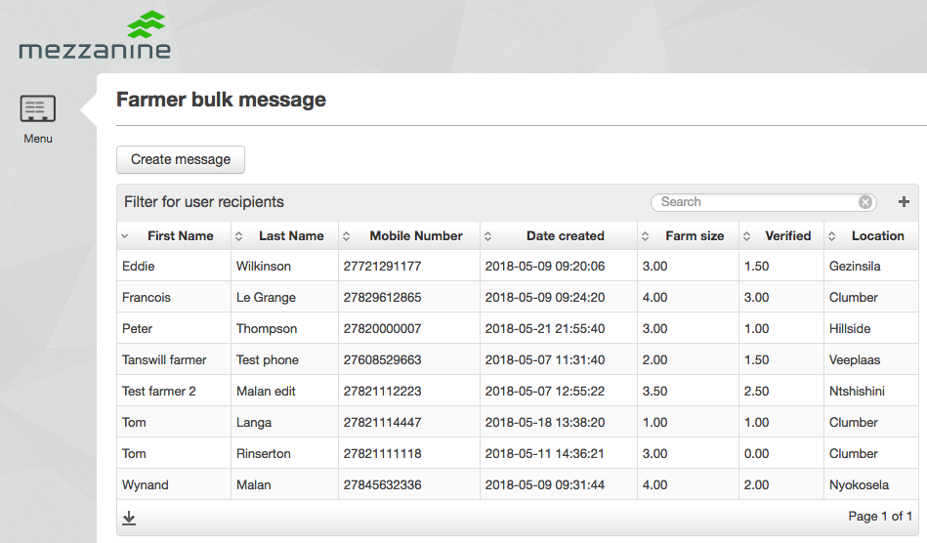
Messaging #1
Web user #1 selects farmers and types the SMS.
Web user #2 must review SMS and approve it.
Only then will SMS go to farmers.

Slide 18
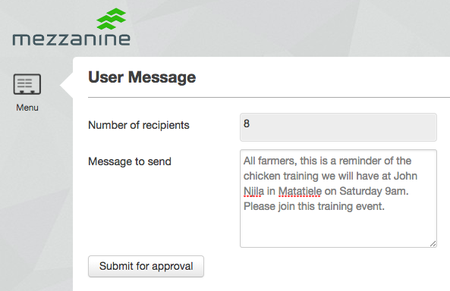
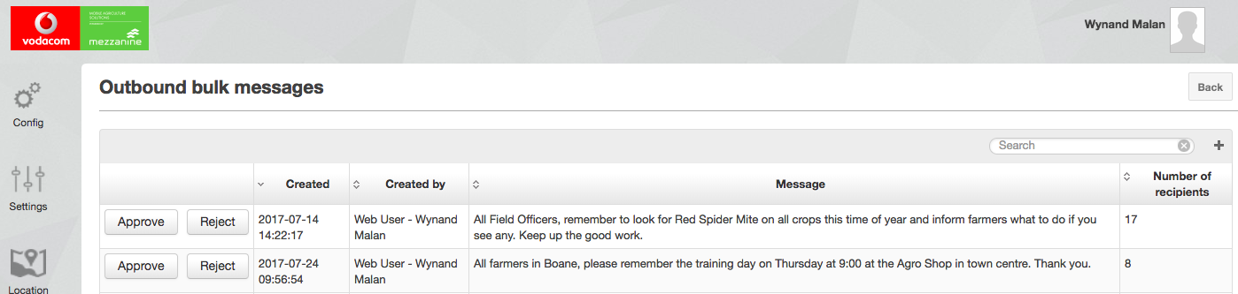
Messaging #2
Web user #2 must review SMS and approve it.
Only then will SMS go to farmers.

Slide 19
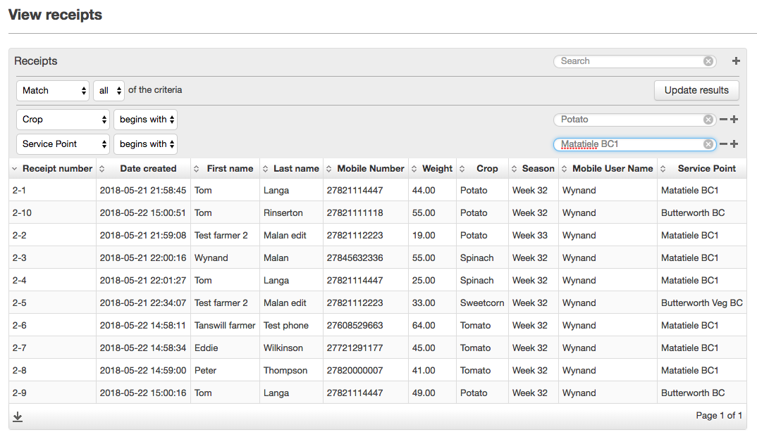
Web table = Report
You can use the [+] as an advanced search on any web table to select a subset of data and click the CSV download arrow.
Click on the header to sort by this column
(See change in the ^)
1
3
4
2
5

Slide 20
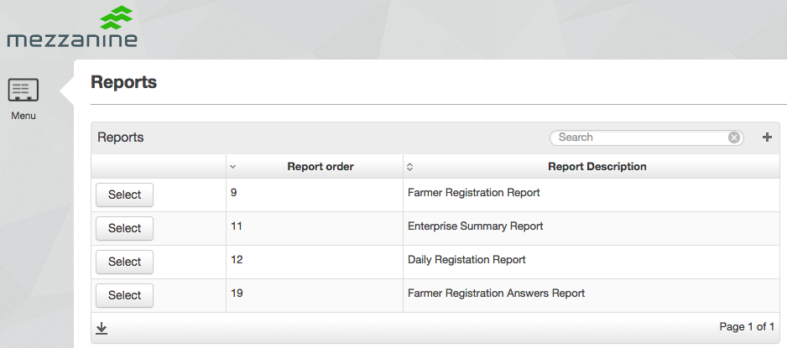
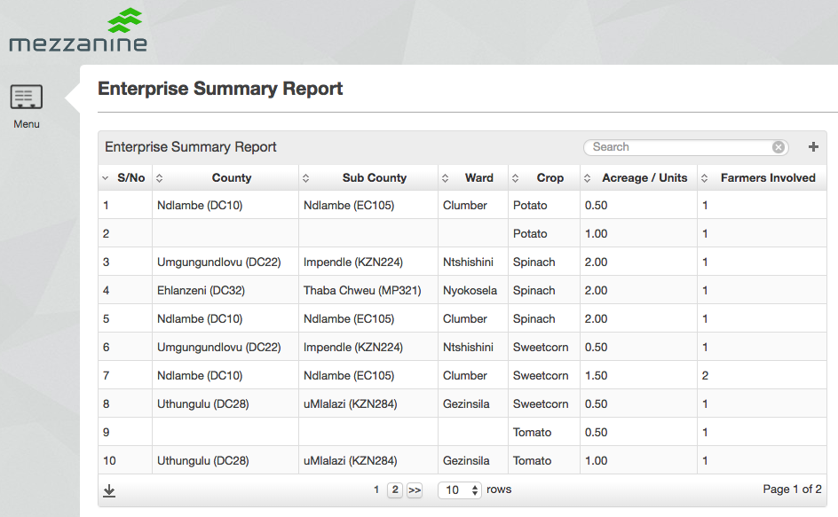
Pre-configured Reports

Slide 21
Support process & External Support pages
1st Line Support:
When users and farmers needs support or re-training, this is provided by the Customer support / IT person or manager.
2nd Line Support:
Connectivity, app or software faults must be logged through the correct channels with sufficient detail about the user and the issue.
3rd Line Support:
Connectivity or Vodacom sim issues of mobile app users: dial 1940
Connected Farmer app / software issues: Mezzanine Support desk
021 880 2222
support@mezzanineware.com
Web page support
Mobile app support
Device support

Slide 22
Thank You
Siyabonga
Enkosi

Slide 23
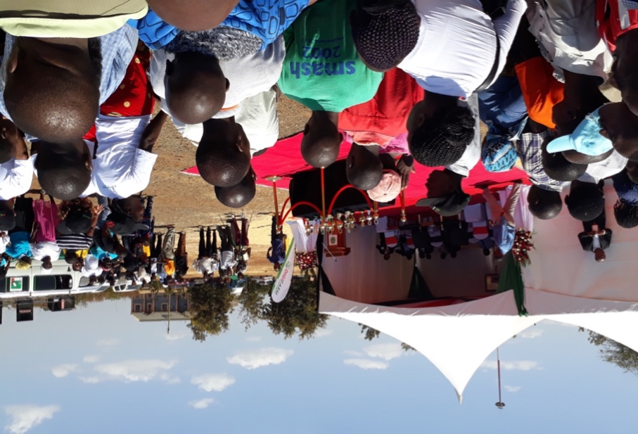
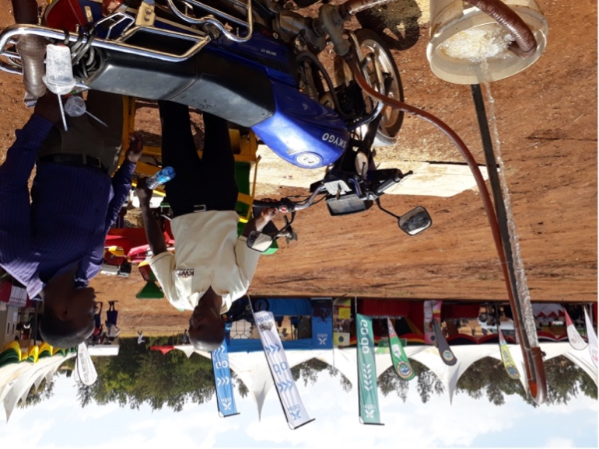
Digifarm: Consumer software services to farmers in Kenya
Services to farmers via feature phone includes:
  Content on Agriculture production best practice
  Access to credit to buy inputs
  Access to inputs from participating iProcure shops across the counties where Digifarm has been rolled out
More than 750 000 farmers registered as Digifarmers
Total loan value redeemed by 4 500 loan transactions in the last 4 months: Ksh 6.4m ($64 000)
Phase 3 in design stage to on-board more services and information to farmers

Slide 24
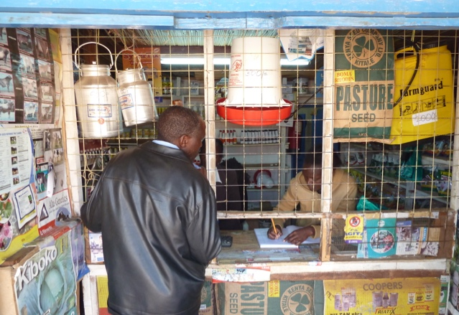










eVoucher Solution
Access to quality inputs – when and where it is needed
Cashless Value Distribution
“Closed voucher system” enable targeted subsidies
Stock management
1
2
3
4
5
Register
Agro Dealer &
Voucher
Categories
Recon between
Client
and Agro Dealer
Issue
e-Voucher
Redeem
e-Voucher
at Agro Dealer
Register
Farmer
App
Web
SMS
App
Web
18 February 2020

Slide 25
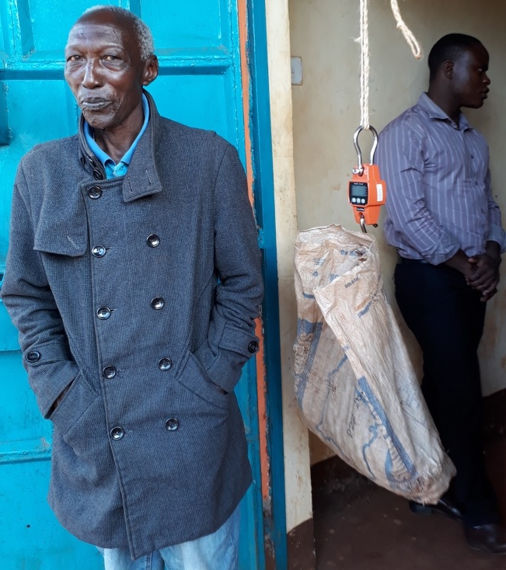

Connected Farmer Seasonal Solution
eReceipts & real-time mobile money payments
Enterprise Solution to the Agribusiness
  Reduces risk of cash – farmer and business
  Visibility on transactions and stock levels
Kenya Nut Company
  60 000+ transaction in 2017 season
  $2.2m+ paid in M-Pesa = New money into M-Pesa pool
  100% Adoption for Macadamia purchases
Future: Precision Farming & increased production
  Detailed Farmer & Farm profile can inform precision agronomy advice

